Slide 1


Statistical Software Metrics Analysis
Cyrus Kalantarpour

Slide 2
Preparation
We separated the class log and class log at test for Apache and free chart
We concatenated ‘HT Effort’ column along with class test logs for Apache and Free chart
Therefore, we have 4 excel sheets as follows:
1: Apache class logs.xlsx
2: Apache class logs at test.xlsx
3: Free chart class logs at test.xlsx
4: Free chart class logs.xlsx
Then, we read the data (excel sheets) with Pandas (a python framework).
Next step we use ‘dropna’ method to remove Nan data cells.

Slide 3
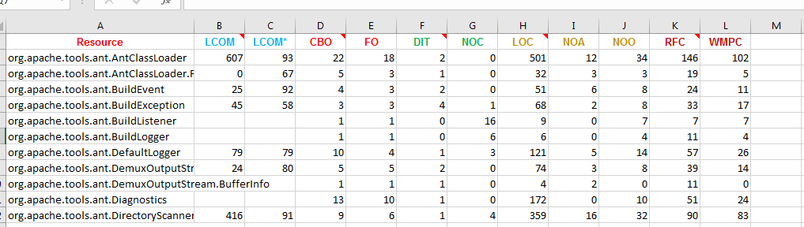
Prepared Excel sheets preview
1: Apache class logs.xlsx

Slide 4
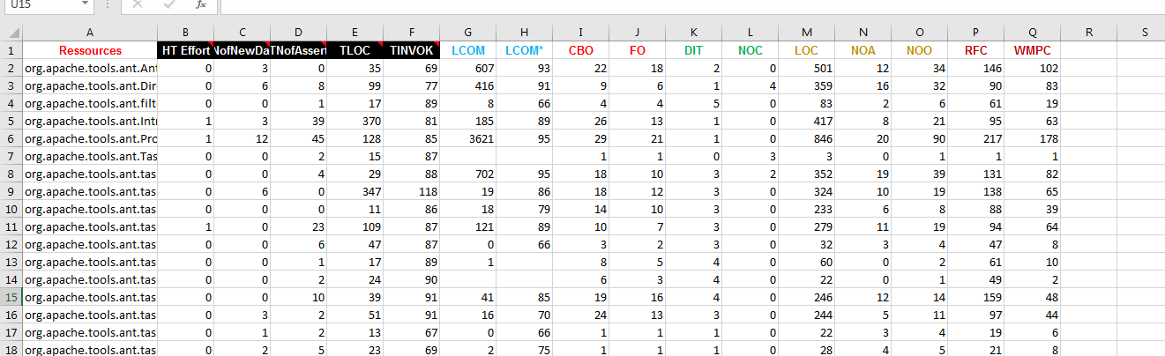
Prepared Excel sheets preview
2: Apache class logs at test.xlsx

Slide 5
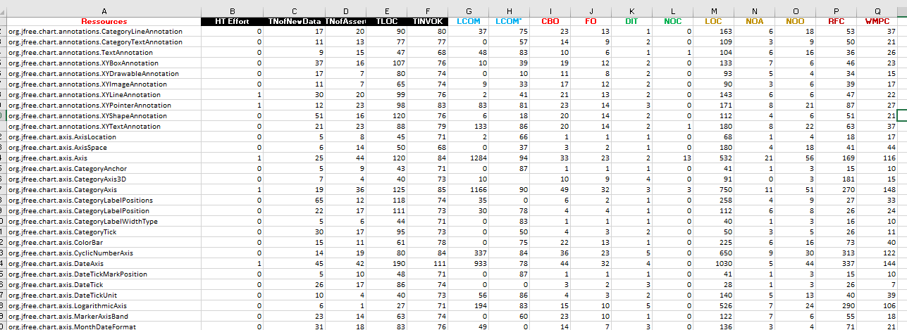
Prepared Excel sheets preview
Free chart class logs at test.xlsx

Slide 6
Prepared Excel sheets preview
Free chart class logs.xlsx

Slide 7
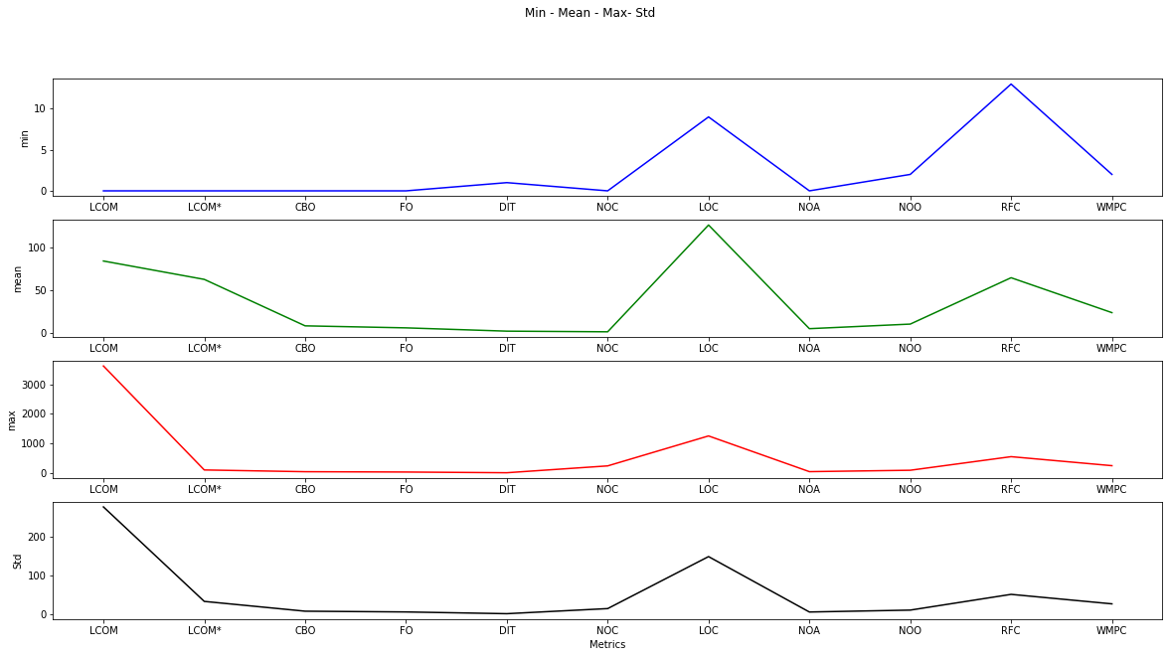
Descriptive Analysis for Apache classes data (0)

Slide 8
Descriptive Analysis for Apache classes data (1)
A Good software design has high cohesion and low coupling
According to the plots:
Some of the classes have low LCOM and the LCOM standard deviation is High. So, the overall cohesion is not so good.
CBO is low which demonstrates low Coupling.
We can divide the metrics into 3 groups based on their function as follows:
1: Identification of Classes - WMC, DIT, NOC
2: Semantics of Classes - WMC, RFC, LCOM
3: Relationships between classes - RFC, CBO

Slide 9
Descriptive Analysis for Apache classes data (2)
Based on the previous metrics division:
The classes identification quality is acceptable which means that the design of software is not complex.
The classes Semantic quality is not bad but since RFC is high the debugging should be a little hard.
The relationships between classes is good since the CBO is low and therefore the number of classes which are wrote for the apache is good. But since the RFC is high, we can say the classes’ design would have been better to improve.

Slide 10
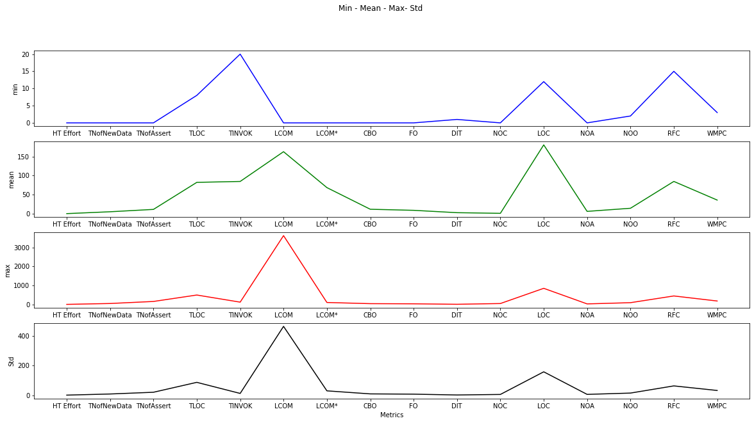
Mean and Standard deviation analysis for Apache test (0)

Slide 11
Mean and Standard deviation analysis for Apache test (1)
According to the plots:
Compared to class metrics logs Apache the Cohesion is slightly better
CBO is low which demonstrates low Coupling.
By dividing the metrics into 3 groups based on their function as follows:
1: Identification of Classes - WMC, DIT, NOC
2: Semantics of Classes - WMC, RFC, LCOM
3: Relationships between classes - RFC, CBO

Slide 12
Mean and Standard deviation analysis for Apache test (2)
The classes identification is good, and the complexity is normal.
The classes Semantics is not bad, but the RFC is a little high.
Although the RFC is high, since the CBO is very low the relationship between classes still is good.

Slide 13
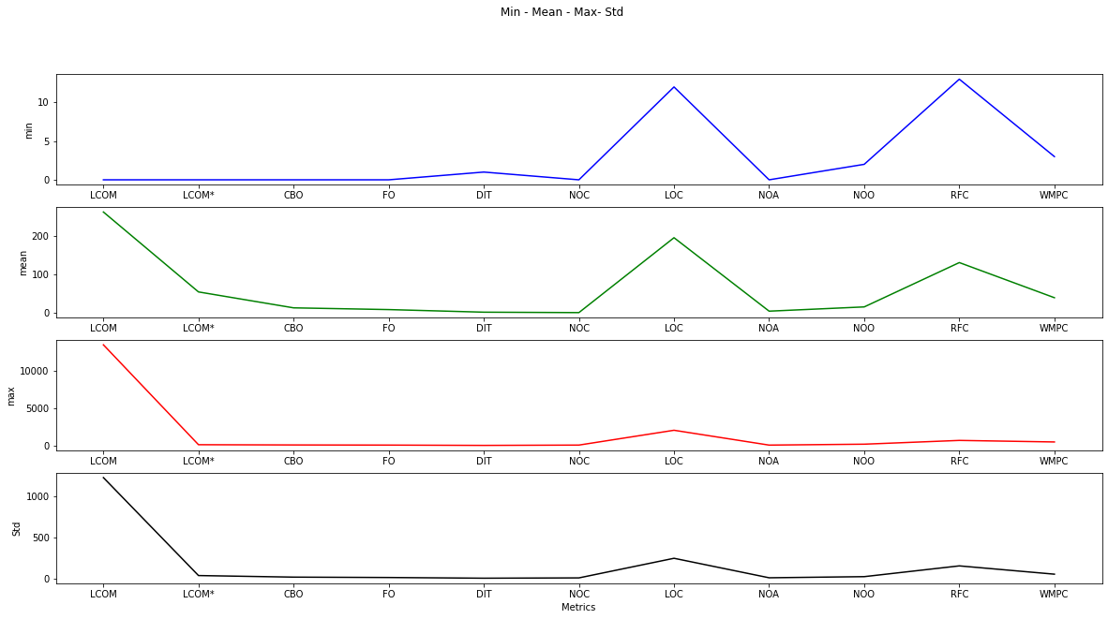
Mean and Standard deviation analysis for Free chart (0)

Slide 14
Mean and Standard deviation analysis for Free chart (1)
According to the plots:
LOCM has high standard deviation and some of the classes have too low LCOM. As a result, the overall cohesion is not satisfying.
The coupling between classes is very good.
The RFC is low with respect to the total number of the classes. Therefore, the response sets of the classes are good.

Slide 15
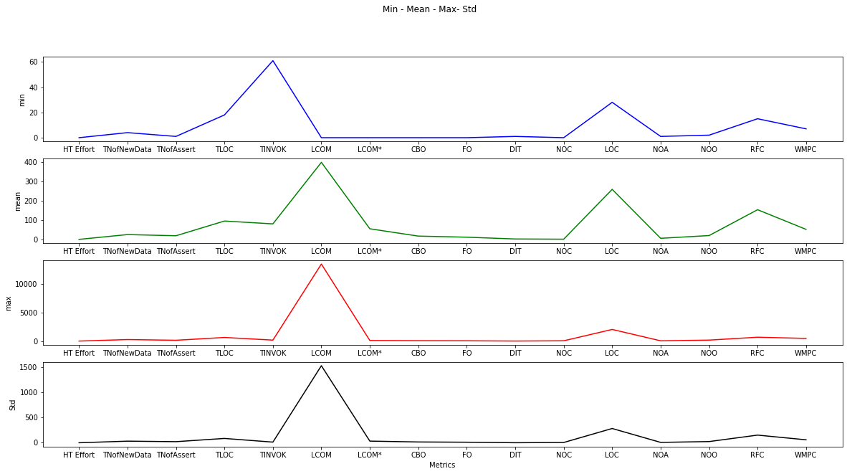
Mean and Standard deviation analysis for Free chart class at test (0)

Slide 16
Mean and Standard deviation analysis for Free chart test (1)
LCOM standard deviation is too high. So, Cohesion is not good.
CBO, FO and DIT are very low and have low standard deviation. Therefore, the class couplings are very good.
RFC is high but has sight standard deviation. So, class method relation is high, and there will be lots of internal class method calls which is not good.

Slide 17
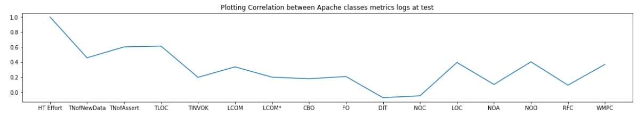
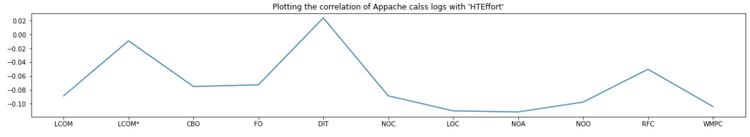
Correlation analysis for Apache

Slide 18
Correlation analysis for Apache
According to the plots:
TLOC has 0.6 correlation with HT Effort.
LOC, NOO and WMPC have around 0.4 correlation with HT Effort.
There is no way to predict Effort without class log at tests.
Probably LOC, NOO and WMPC are best candidate to use univariable logestic regression.

Slide 19
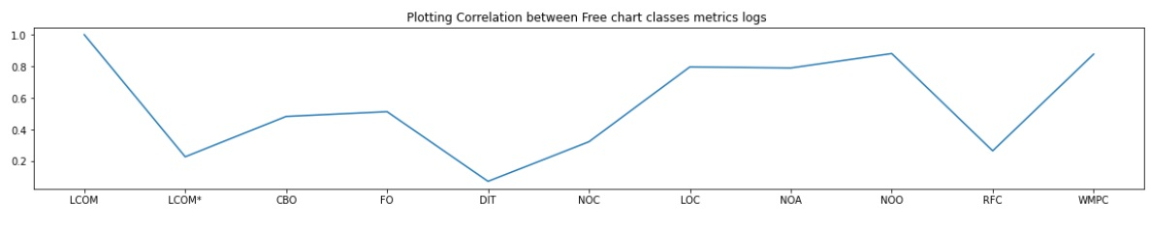
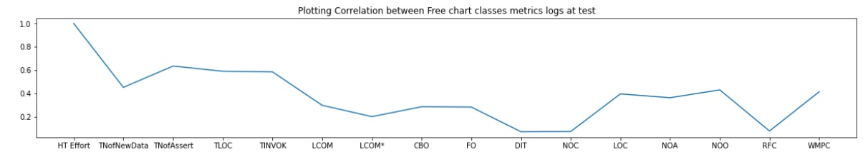
Correlation analysis for Free chart

Slide 20
Correlation analysis for Free chart
There is a significant correlation between LCOM, LOC, NOO, WMPC
There is 0.4 correlation between Ht Effort and LOC, NOA, NOO.
There is 0.6 correlation between Ht Effort and TINVOK, TNofNewData and Assert .

Slide 21
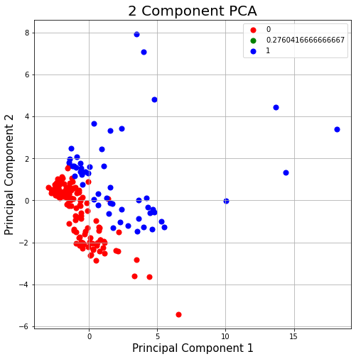
PCA for Free chart class logs at test
Here is the result of PCA to predict the Ht Effort which tells us there are enough information contained in the metrics to predict the Ht Effort

Slide 22
Logistic regression
I applied the Uni variable logistic regression selectively on the highly correlated metrics with the HtEffort.
I got 0.631578947368421 score for (HtEffort and NOO)
I got 0.6153846153846154 score for (HtEffort and FO)

Slide 23
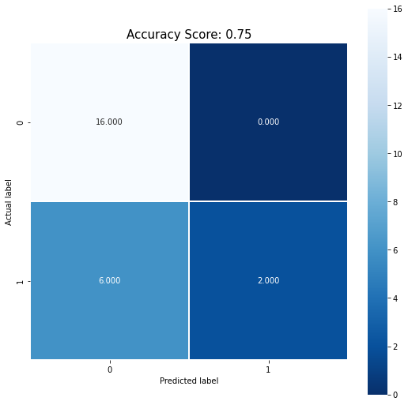
Multi-variate logistic regression
I got 0.75 prediction score to predict Ht effort via Multi-variate logistic regression. Here is the confusion matrix:

